Slide 1
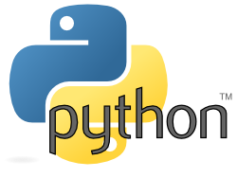
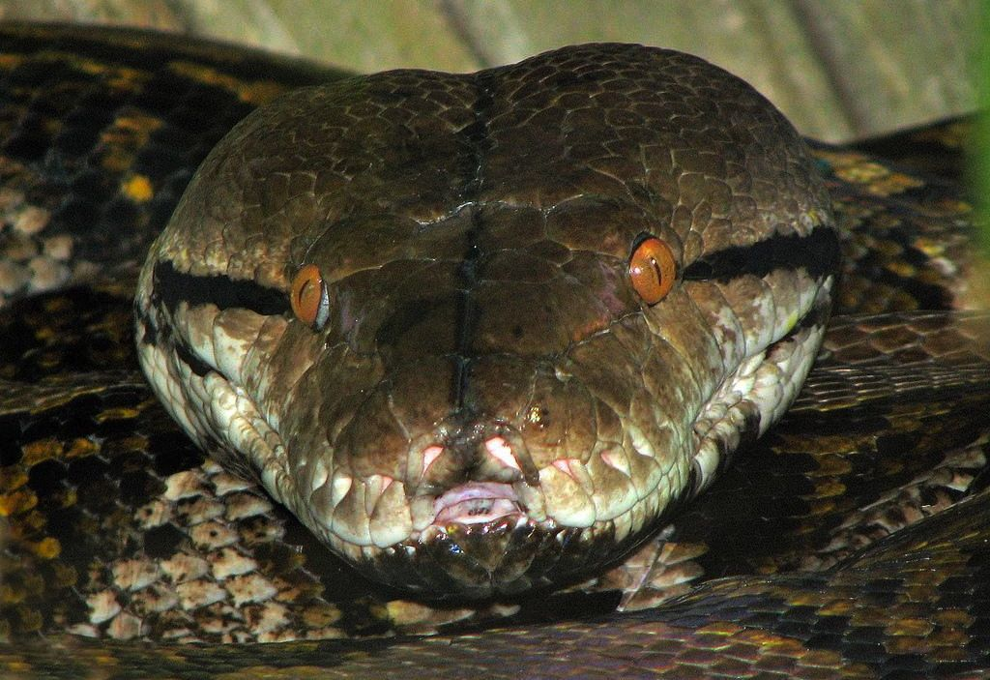
WORKING WITH FUNCTIONS

Slide 2
What is Function?

Slide 3
What is Function?
A function is a group of statements that is executed when it is called from some point of the program.
It’s a divide and conquer approach

Slide 4
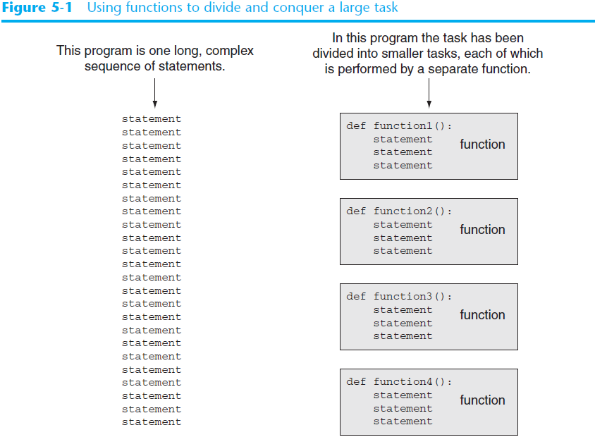

Slide 5
TYPES OF FUNCTIONS

Slide 6
TYPES OF FUNCTIONS
Functions can be categorized into three types:-
1) Built in Functions.
2) Modules.
3) User - defined functions.

Slide 7
TYPES OF FUNCTIONS
1) BUILT IN FUNCTIONS
These are predefined function in python and are used as and when there is need by simply calling them. For example:
int()
float()
str()
min()
max() ...etc

Slide 8
TYPES OF FUNCTIONS
2) MODULES
Module is a container of functions, variables, constants, class in a separate file which can be reused.

Slide 9
IMPORTING MODULES
i) Import statement
ii) from statement

Slide 10
IMPORTING MODULES – import STATEMENT
i) import statement : used to import entire module.
Syntax: import modulename
example: import math

Slide 11
IMPORTING MODULES – import STATEMENT
ii) from: import all functions or selected one.
Syntax:
from module name import function name
for example:
from random import randint

Slide 12
3) USER DEFINED FUNCIONS
Function is a set of statements that performs specific task.
Syntax of user defined function
def function_name(list of parameters)
................
................
Statements
def is keyword

Slide 13
Defining and Calling a Function (cont’d.)
Function name should be descriptive of the task carried out by the function
  Often includes a verb
Function definition: specifies what function does
  def function_name():
    statement
    statement
Function header: first line of function
  Includes keyword def and function name, followed by parentheses and colon
Block: set of statements that belong together as a group
  Example: the statements included in a function

Slide 14
Defining and Calling a Function (cont’d.)
Call a function to execute it
  When a function is called:
    Interpreter jumps to the function and executes statements in the block
    Interpreter jumps back to part of program that called the function
      Known as function return

